Slide 1

Note: The data and information in this document is reflective of a hypothetical situation and client. This document is to be used for KPMG Virtual Internship purposes only.
Sprocket Central Pty Ltd
Data analytics approach
[Analytics] - [Jeantel Cassius], [JeffKermane], [Jean Yvens Alberus]

Slide 2
Note: The data and information in this document is reflective of a hypothetical situation and client. This document is to be used for KPMG Virtual Internship purposes only.
Agenda
Introduction
Data Exploration
Model Development
Interpretation

Slide 3
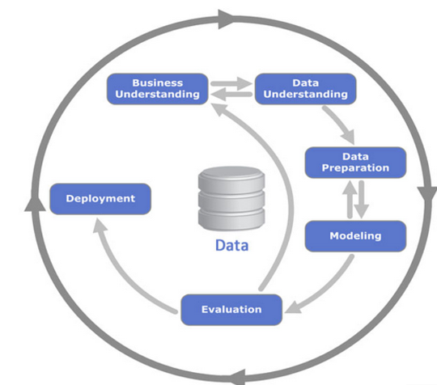
Note: The data and information in this document is reflective of a hypothetical situation and client. This document is to be used for KPMG Virtual Internship purposes only.
Introduction
The business Task: optimize resource allocation for targeted marketing. Hence, improve performance by focusing on high value customers.
Objective.
determine customer trends and behavior.
Create the perfile of the high value customers as per the data.
Predict which ones of the new 1000 clients will drive the most value to the business.
Place any supporting images, graphs, data or extra text here.

Slide 4
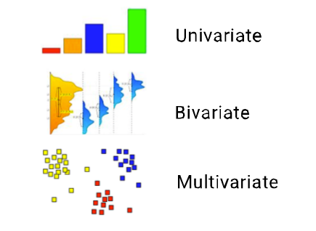
Note: The data and information in this document is reflective of a hypothetical situation and client. This document is to be used for KPMG Virtual Internship purposes only.
Data Exploration
Understand the distributions, correlations, outliers, trends and other characteristics
Is the available data sufficient and suitable to achieve the project goals?
Is the data plausible or suffers from acquisition or transformation artefacts?
Do we know enough about the causes of anomalies, trends, gaps, etc.?
Which data-subsets (e.g. variables, time periods) can (not) be used for building predictive models?
Place any supporting images, graphs, data or extra text here.

Slide 5
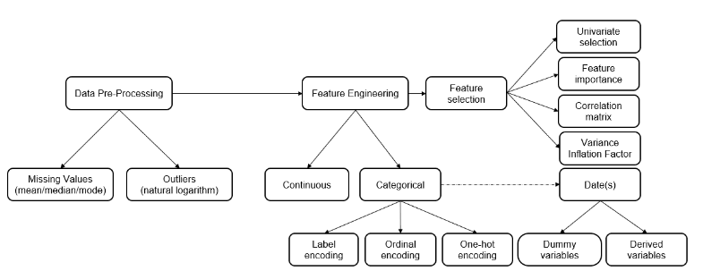
Note: The data and information in this document is reflective of a hypothetical situation and client. This document is to be used for KPMG Virtual Internship purposes only.
Model Development
Supervised model: Regression (linear, logistic)
Place any supporting images, graphs, data or extra text here.

Slide 6
Note: The data and information in this document is reflective of a hypothetical situation and client. This document is to be used for KPMG Virtual Internship purposes only.
Interpretation
Interpretation of mined patterns
Interpretation of mined patterns
Visualization of extracted patterns and models
Visualization of the data given the extracted
Dashboard

